Slide 1
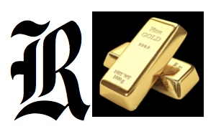
Slide 1
Rubicon Resources Pty Ltd
ABN 34 645 608 895
Date: August 2024
RUBICON RESOURCES AUSTRALIA
UNIQUE OPPORTUNITY TO PARTICIPATE
IN GOLD & RARE EARTH ELEMENT
EXPLORATION PROJECTS IN AUSTRALIA
With a Minimum Investment of just AU$10,000
into current Seed Round offering of AU$2,000,000
v240801

Slide 2
Slide 2
Rubicon Resources Pty Ltd
Australia – a Mineral Rich Country
Australia is a Mineral Rich Country ranked 8th in the World with substantial resources of gold, coal, iron ore, copper, uranium and many other elements.
Australia is the world’s largest net exporter of coal, the largest producer of iron ore, lithium, bauxite, the second largest producer of gold and the fourth largest producer of rare earth elements (REE’s).
The Olympic Dam Mine in South Australia hosts one of the world’s largest deposits of uranium and the fourth largest copper deposit.

Slide 3
Slide 3
Rubicon Resources Pty Ltd
COMPANY SNAPSHOT
Rubicon was founded in November 2020 to conduct exploration and mining in Australia.
Board of Directors & Management Team with skill sets aligned to the company’s core business of exploration, mining & mineral extraction.
Exploration focused on Gold, Silver, Rare Earth Elements and Critical Minerals needed to meet Zero Emissions Targets.
Priority exploration focus on two promising targets that have been located in the same Exploration Licence (EL9354) in western NSW, Australia – a Gold-Copper Prospect and a Rare Earth Element Prospect – Rubicon has exclusive rights to acquire this Licence.

Slide 4
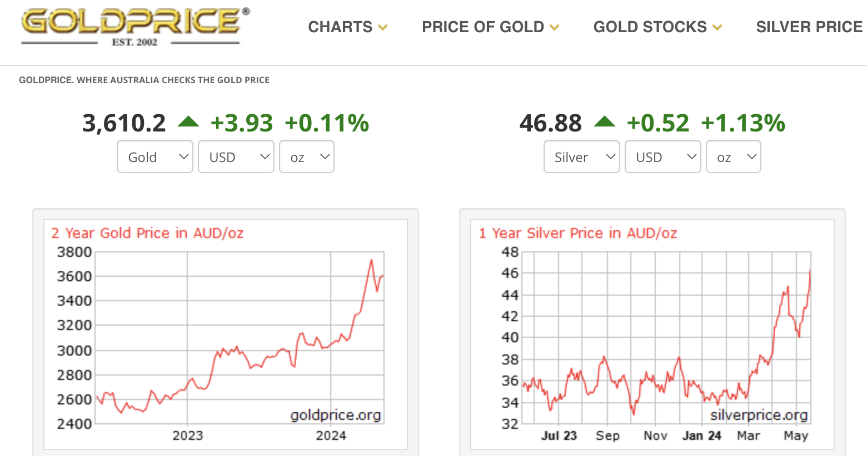
Slide 4
Rubicon Resources Pty Ltd
EXPLORATION FOCUS
Target Commodities sought are – Gold, Silver, Copper & Rare Earth Elements (REE).
Focus locations for exploration – current, EL9354 in western New South Wales, Australia
All these metals are showing strong upside price potential and demand is increasing world wide.
Price Chart Gold & Silver AU$ -20th May 2024

Slide 5
Slide 5
Rubicon Resources Pty Ltd
GLOBAL MARKET SITUATION
Gold – there is a ready market for gold and it is easily exchangeable for cash.
Rare Earth Elements & Copper – the demand for these metals is increasing in order to meet Zero Emissions Targets.
The U.S. Government is concerned about current reliance on China with around 60% of world production to provide rare earth elements which are strategically important and is looking to Australia to supply more of its requirements.
The US Government through the Export-Import Bank of the United States has provided a Letter of Interest to fund up to AU$923M for a REE exploration company just a few hours drive from EL9354.

Slide 6
Slide 6
Rubicon Resources Pty Ltd
EXPLORATION STRATEGY
One of the greatest success stories in Australian mineral exploration was discovery of the Olympic Dam Mine which contains the largest mineral deposit yet identified in Australia.
Studies have shown that major mineral deposits in Australia and worldwide lie in or near the intersection of lineaments which represent the earth’s major crustal faults.
Rubicon, employing a similar approach to that used in the discovery of Olympic Dam Mine, has identified exploration sites for gold and rare earth elements using O’Driscoll’s lineament map of Australia in combination with gravity & magnetic geophysics.
Follow-up soil geochemistry confirmed precisely defined search locations.

Slide 7
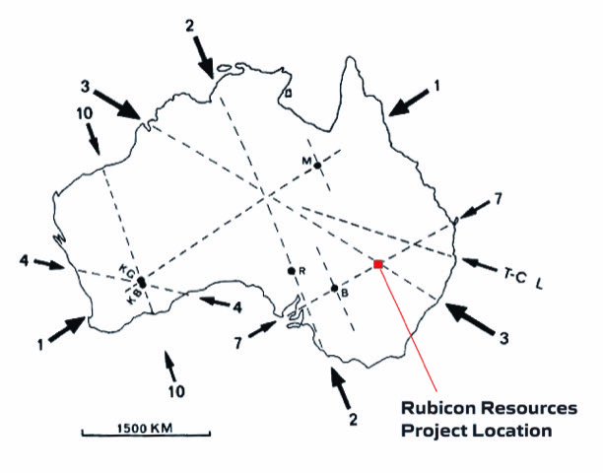
Slide 7
Rubicon Resources Pty Ltd
O’Driscoll’s Lineament Map of Australia
Legend:
These are the largest mining sites in Australia all of which are at or close to major lineament intersections.
M = Mt Isa Mining Region
B = Broken Hill Mine
R = Roxby Downs - Olympic Dam Mine
KG = Kalgoorlie
KB = Kambalda

Slide 8

Slide 8
Rubicon Resources Pty Ltd
A TEAM BUILT FOR SUCCESS

Slide 9
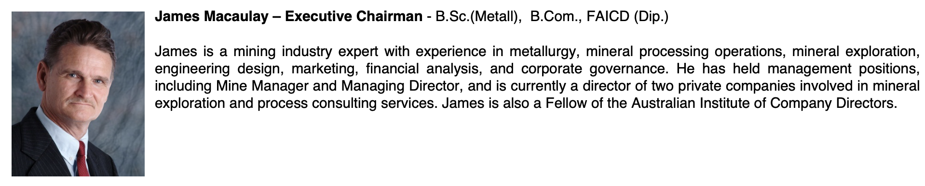
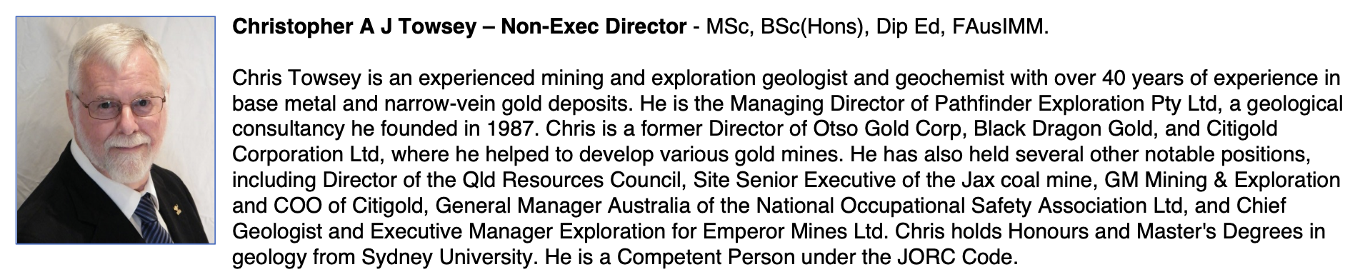
Slide 9
Rubicon Resources Pty Ltd
QUALIFICATIONS – DIRECTORS & MANAGEMENT

Slide 10
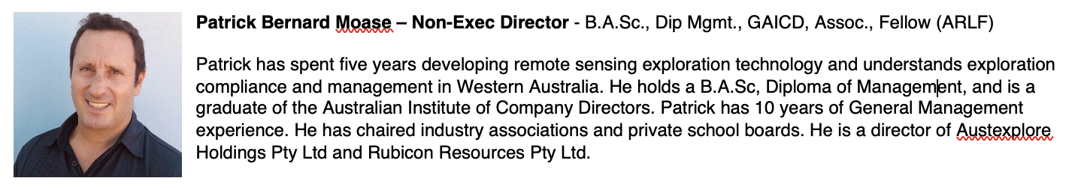
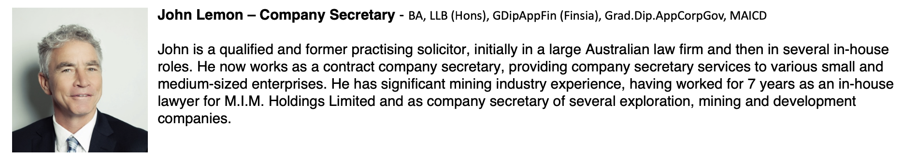
Slide 10
Rubicon Resources Pty Ltd
QUALIFICATIONS – DIRECTORS & MANAGEMENT (contd.)

Slide 11
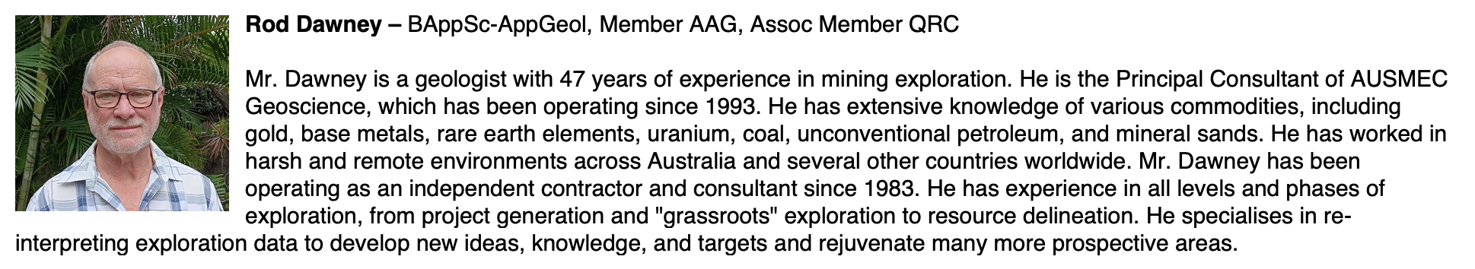
Slide 11
Rubicon Resources Pty Ltd
QUALIFICATIONS – PRINCIPAL GEOLOGICAL CONSULTANT

Slide 12
Slide 12
Rubicon Resources Pty Ltd
Our Vision
“To plant a seed that in time, grows into a large mining company.”
Two Exciting Prospects Discovered in Western NSW, Australia
A Gold-Copper-Cobalt prospect that shows a strong soil “geochemical anomaly”* for these elements over a length of 20 km and with an average width of 2 km;
A Rare Earth Element prospect with a strong soil “geochemical anomaly” covering an area of 5 sq km and which appears likely to be near surface ion adsorption type that brings with it the benefits of low mining and extraction costs.
*“Geochemical Anomalies” defined by the mobile metal ion technique are very effective for locating deeply buried mineral deposits due to migration of metal ions to surface soil where they are adsorbed onto clay particles and oxide coatings.

Slide 13
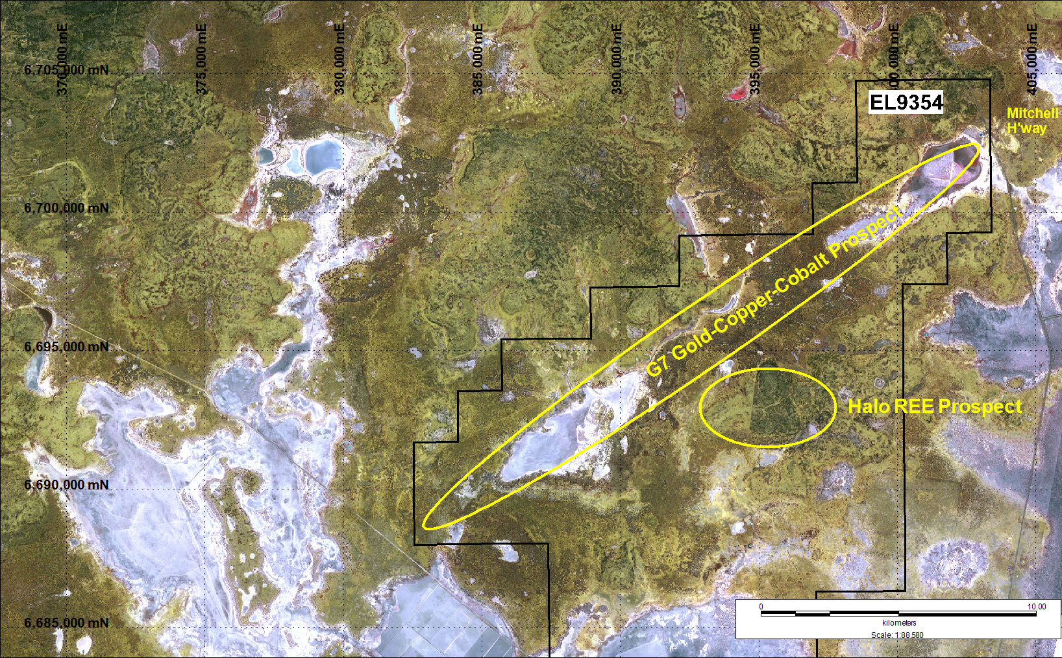
Slide 13
Rubicon Resources Pty Ltd
Location of the Two Exciting Prospects

Slide 14
Slide 14
Rubicon Resources Pty Ltd
Exploration Priority 1 – “Halo” REE Target
The Halo Target is located on the extreme southern margin of the G7 Lineament as indicated by gravity geophysics.
The Halo Target is characterized by a particularly strong soil geochemical anomaly for REE’s.
REE mineralization is indicated to be readily accessible, near surface ion adsorption type with the benefits of low capital and operating costs.
Initial focus will be on a specific 5.5 sq km area within EL9354 with another 26 sq km of prospective ground to follow – 21 hole air core drilling program has been approved by the Resource Regulator which gives permission for drilling to occur in NSW.

Slide 15
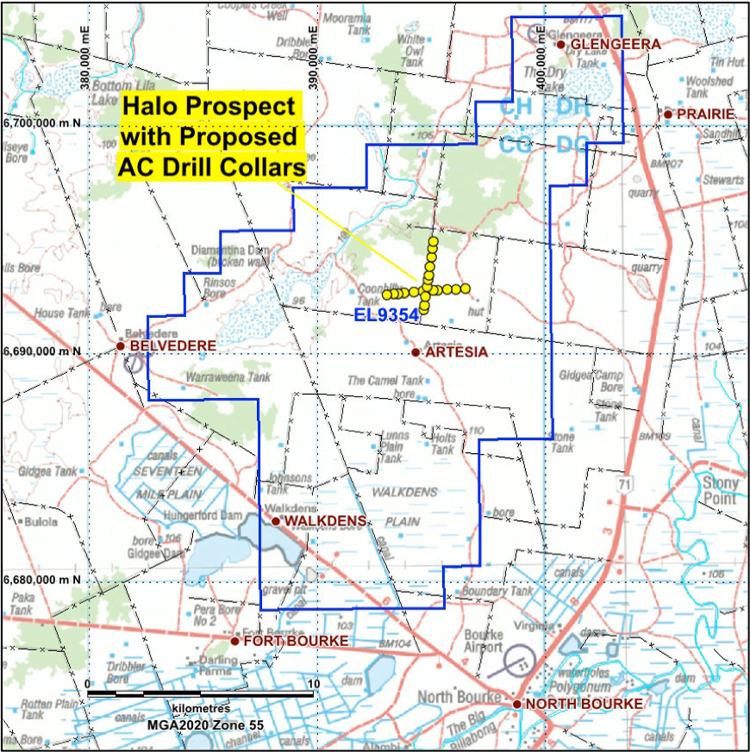
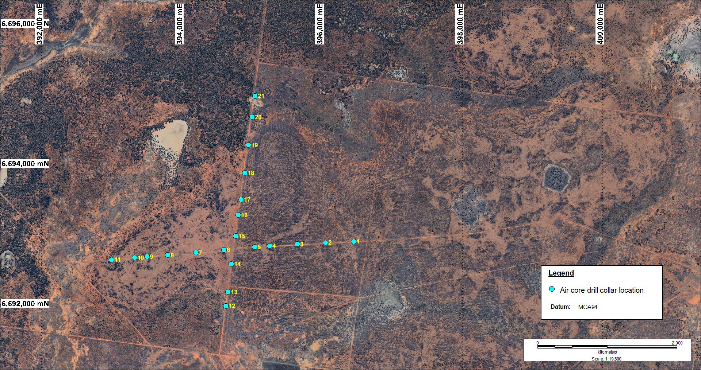
Slide 15
Rubicon Resources Pty Ltd
Planned Air Core Drilling Location – Halo Target

Slide 16
Slide 16
Rubicon Resources Pty Ltd
Comparison “Halo” REE Target with “ASX” Listed Discoveries
(ASX – Australian Securities Exchange)
Rubicon’s REE Prospect in NSW shows a TREE (Total Rare Earth Element) anomaly 10x background which compares favorably to other REE discoveries in Australia.
MTM Critical Mineral (ASX: MTM) – formerly Mt Monger Resources, is optimistic about the economic viability of its comparable near surface REE deposit.
Rubicon’s analysis of soil geochemical data shows a maximum TREE soil geochemical figure of 15,790 ppb which compares favorably to MTM’s Pt Kidman prospect (see Slide 17) and Rubicon’s area of highly elevated TREE is greater than MTM’s.
MTM’s air core drilling assay results suggest that Rubicon is likely to get similar results from its air core drilling program based on the comparison of TREE soil geochemical results from Rubicon and MTM (see Slide 17).

Slide 17
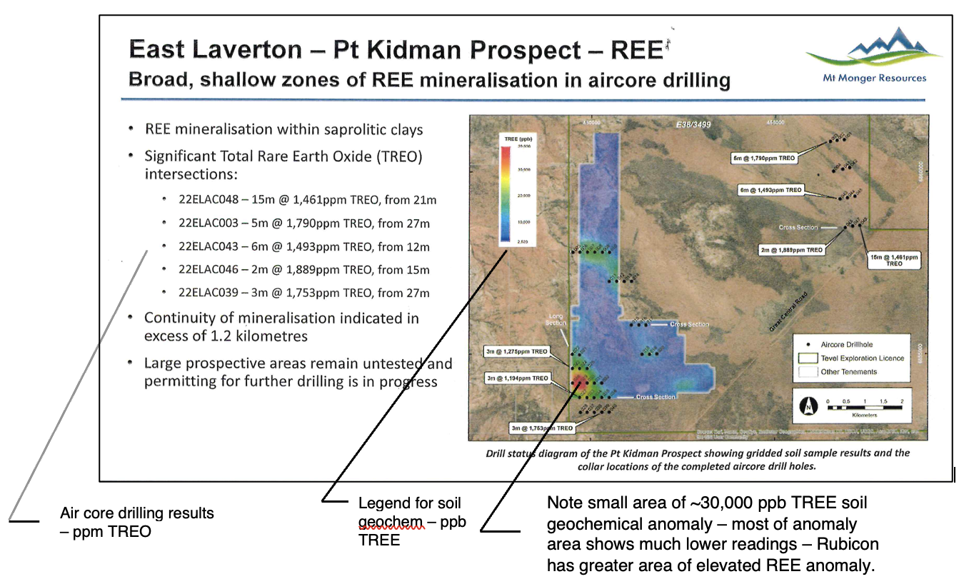
Slide 17
Rubicon Resources Pty Ltd
Comparison “Halo” Target to MTM’s Pt Kidman Project

Slide 18
Slide 18
Rubicon Resources Pty Ltd
Exploration Priority 2 – “G7 Target” Gold-Copper-Cobalt
Located along the southern margin of the G7 Lineament and positioned 1 km north of the “Halo” Target.
Exploration target broadly identified from lineament intersection and accurately located using gravity and magnetic geophysics followed up by mobile metal ion soil geochemical sampling.
Considered to be a very prospective exploration target on the basis of soil geochemical data with mineralization expected to occur within basement beneath 150-200 m of covering sediments.

Slide 19
Slide 19
Rubicon Resources Pty Ltd
Strong Gold-Copper Soil Anomaly* at “G7 Target”
Comparable soil geochemical sampling profiles along an 11 km length of the centre-line of the “G7 Target” were noted from two methods – ALS Ionic Leach and Labwest UltraFines methods.
Based on prior experience in this area where basement rocks are covered by Artesian Basin Sediments, Gold readings by Ionic Leach method above 1ppb are considered to be anomalous – the highest Gold reading of 5.96 ppb by this method is highly anomalous.
Ionic Leach maximum reading for Copper was 1,585 ppb which is also highly anomalous.
Further soil geochemical cross line sampling suggests the zone of copper anomaly may be larger than originally thought – indicated length 20 km x 2 km width.
*A “Soil Anomaly” assists in identifying the precise location of an area which is likely to carry mineralisation at depth and the strength of the anomaly gives a very favourable indication that underlying mineralisation may be of economic grade. In turn, the apparent area of the copper anomaly at 40 sq km (as indicated by soil sampling carried out to date) suggests that the anomaly may represent a very substantial body of copper mineralisation that also carries gold and cobalt.

Slide 20
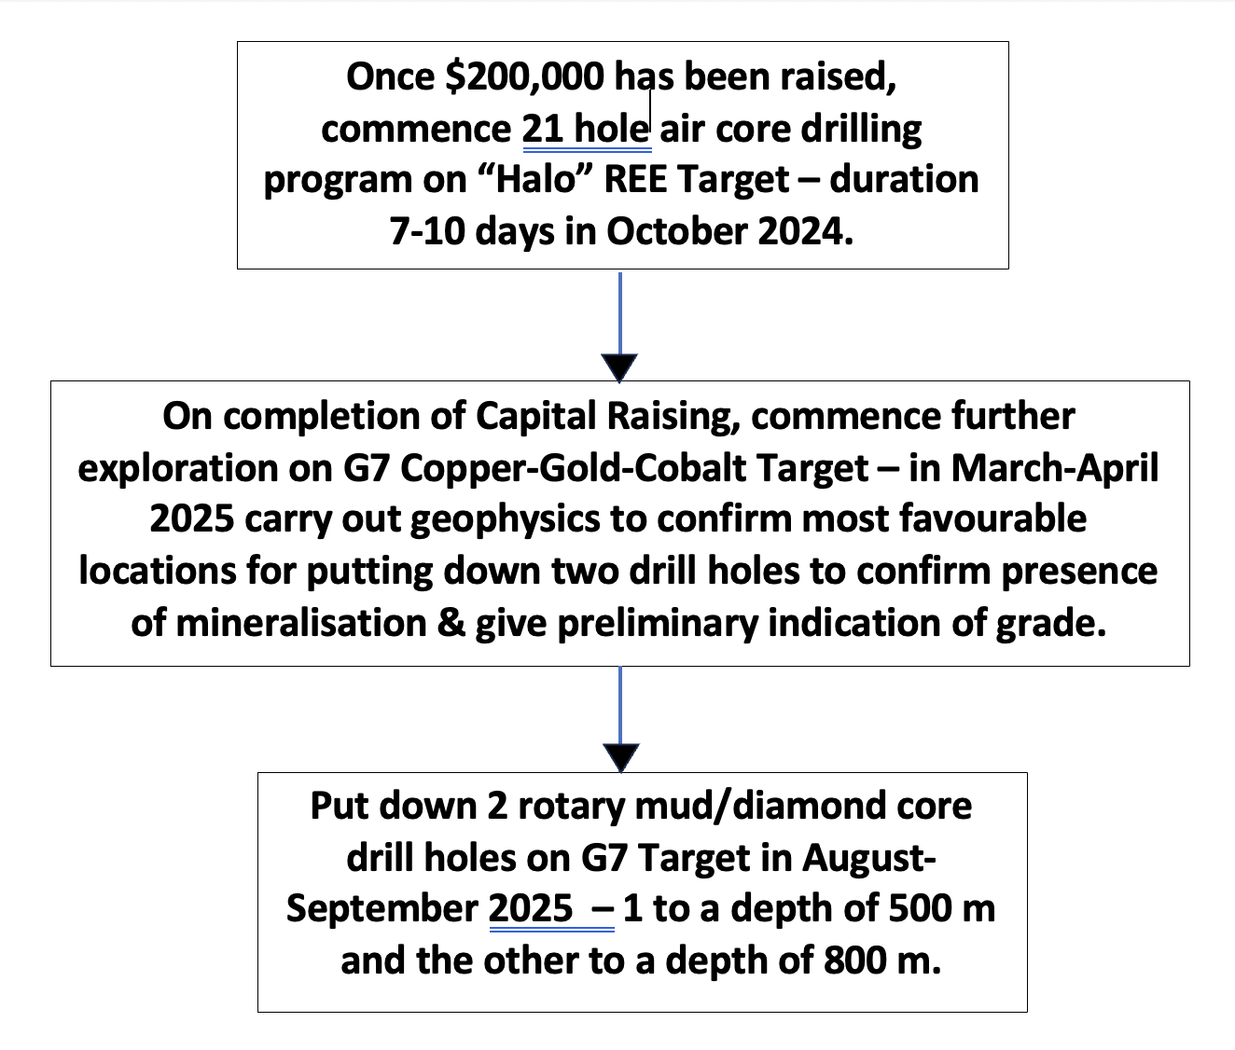
Slide 19
Rubicon Resources Pty Ltd
TIMELINE FOR NEXT STAGES OF EXPLORATION

Slide 21
Slide 20
Rubicon Resources Pty Ltd
Benefits to Investors in this Seed Capital Raising
Investors who come in at this early stage stand to make a much higher return on investment than those who come in later.
While a speculative investment, this is considered to have a favorable risk-return scenario and investors in this Round will own 75% of the equity in Rubicon Resources.
IPO with listing on the ASX planned in 24 months from completion of this capital raising.
Planned to issue Vendor Options on a 1 for 4 basis to Seed Round investors at a 25% discount to the IPO listing price.
Aim to maintain asset backing of share price during any escrow period through Joint Ventures or acquisition of new assets.
Exploration results expected to be very positive from Priority 1 & 2 Targets especially given the promising early mineralization/exploration results and the Rubicon Resources exploration location at the intersection of major Australian Lineaments 3 and 7 (see Slide 7).

Slide 22
Slide 21
Rubicon Resources Pty Ltd
Terms of Investment
Contact Details
Name : James MACAULAY
Email : james.macaulay@rubiconresources.com.au
SMS to : 0413 760288
Further Information
Both Short-form & Full-length Information Memorandums plus share application form available upon request.
Amount to be Raised | AU$2.0 million
Offer Price | AU$0.01 per fully paid share
Minimum Investment Amount | AU$10,000

